Slide 1

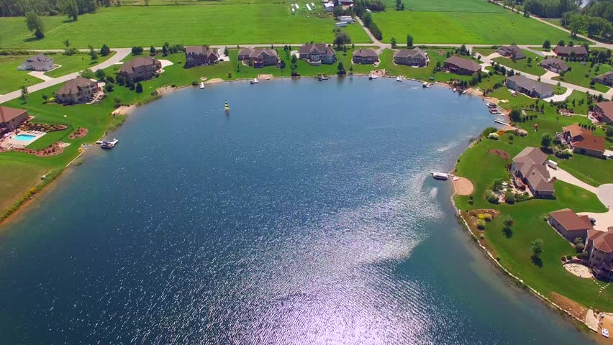
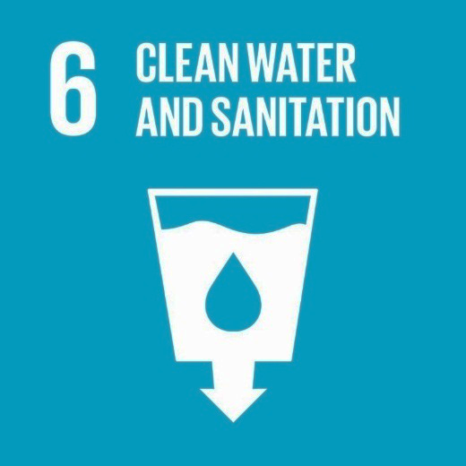
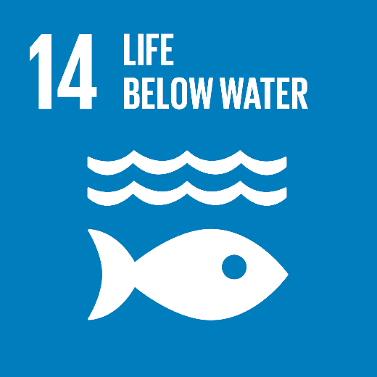
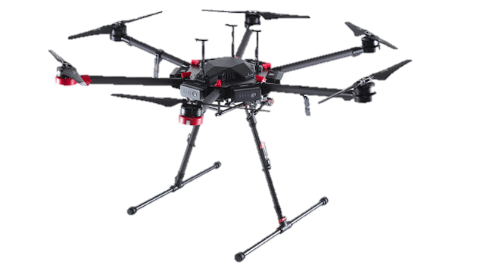

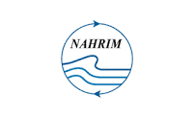

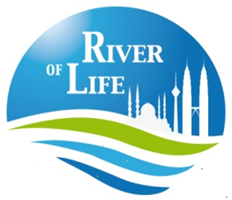

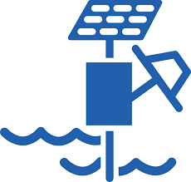
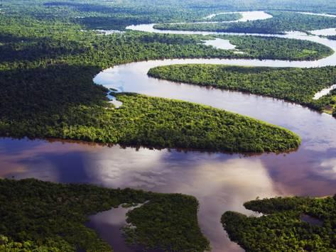
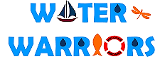

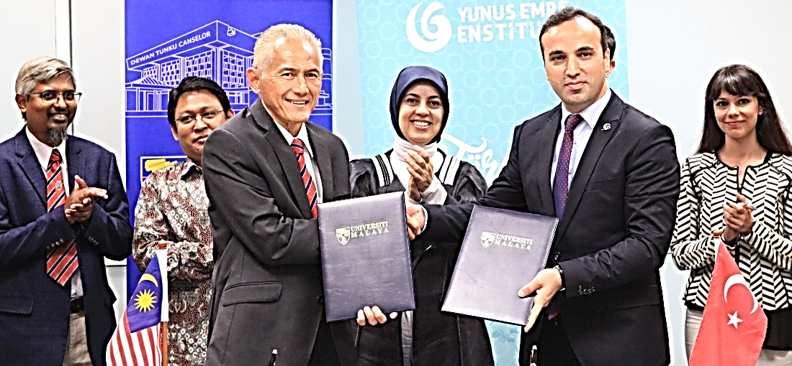

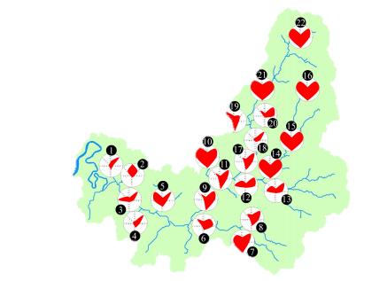

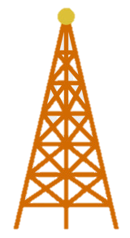
The Global and
Local Priorities
COLLABORATIVE IR4.0 STRATEGIES FOR LAKE AND RIVER CONSERVATION
MANAGEMENT USING INNOVATIVE SENSING PLATFORMS
1
1
Research Problem Statement
I
Hydrone
Lake Sampling
2
Autonomous Robots
Simulation
Cloud Computing
Conventional ground-based surveying and remote sensing techniques for periodic sampling of rivers and lakes are laborious, costly and time consuming
3
2
3
Big Data
Internet of Things
System Integration
OUR IR 4.0
SOLUTIONS
JPS
II
River Sampling
Mesh Network
Interdisciplinary International Team Profile
4
III
Real-time
Analytics and Visualization
of Lake and River
ECOHeart-Index
Istanbul Technical University
Science
Engineering
Computer Science & IT
Avionics

Slide 2
30s
The United Nations listed 17 Sustainable Development Goals (SDGs) to ensure our planet can survive in multiple dimensions
Among the 17 SDGs,
no.6 and no.14 are echoed by our local stakeholders
who manage lake and river conservation
like NAHRIM and SPAN for our country
and UM Water Warriors for our university
To perform lake and river conservation,
the most important activity is to perform water sampling
so we can test if the water is safe and have good quality
However, lake and river have different sampling constraints and procedures

Slide 3
1
Min
The biggest constraint for river sampling is it requires daily update
To sample rivers, they must dispatch many officers everyday
Officers must go by foot including secluded areas
The good news is, they only need small amount of water for testing
On the other hand, the biggest constraints for lake sampling is inaccessibility
Officers cannot just go sampling by foot, they need big boats and hire safety officers
More bad news is, they need large amount of water for lab testing
Because parameters at lakes involve algae and further nutrients
Since everything is done manually, which is laborious and costly,
How can we make sampling an easier task for our stakeholders?
In this work, we propose 3 solutions:

Slide 4
1
Min
To improve lake sampling, we propose the use of drone
Our drone can fly and can touch body of water
We call our drone; a Hydrone
Best of all, our drone can carry electronic probe and large water bottles
So it can perform real-time sampling and take home enough water for lab testing
For the river, we propose to install sampling stations for automatic sampling daily
But some stations are in secluded area and no internet available
To make sure no sampling data is lost
We use a mesh network so data from secluded area is transferred to next closest station
Until they reach the station that have internet access
Finally, we will obtain all lake and river data and perform analytics
to communicate and visualize data in easy manner to our stakeholders

Slide 5
30s
In summary
We are heartfelt in our mission to improve lake and river conservation management
To avoid tragedies such as the recent Sg Kim Pasir Gudang
Where 2.43 tonnes worth of chemical waste are dumped into the river
A classic case of lack of monitoring and slow response
Which could easily be avoided with solutions we proposed in this research
Therefore we humbly submit our application
We believe our work is a game-changer
To support our local stakeholders
Thank you!

